Slide 1
NLP

Slide 2
Introduction to NLP
Smoothing and Interpolation

Slide 3
Smoothing
If the vocabulary size is |V|=1M
Too many parameters to estimate even a unigram model
MLE assigns values of 0 to unseen (yet not impossible) data
Let alone bigram or trigram models
Smoothing (regularization)
Reassigning some probability mass to unseen data

Slide 4
Smoothing
How to model novel words?
Or novel bigrams?
Distributing some of the probability mass to allow for novel events
Add-one (Laplace) smoothing:
Bigrams: P(w_{i}|w_{i-1}) = (c(w_{i-1},w_{i})+1)/(c(w_{i-1})+V)
This method reassigns too much probability mass to unseen events
Possible to do add-k instead of add-one
Both of these don’t work well in practice

Slide 5
Advanced Smoothing
Good-Turing
Try to predict the probabilities of unseen events based on the probabilities of seen events
Kneser-Ney
Class-based n-grams

Slide 6
Example
Corpus:
cat dog cat rabbit mouse fish fish mouse hamster hamster fish turtle tiger cat rabbit cat dog dog fox lion
What is the probability the next item is “mouse”?
P_{MLE} (mouse) = 2/20
What is the probability the next item is “elephant” or some other previously unseen animal?
Trickier
Is it 0/20?
Note that P (that the next animal is unseen) > 0
Therefore we need to discount the probabilities of the animals that have already been seen
P_{MLE} (mouse) < 2/20

Slide 7
Good Turing
Idea
Estimate the frequencies of unseen events based on the events seen once
Actual counts c
N_{r} = number of n-grams that occur exactly c times in the corpus
N₀ = total number of n-grams in the corpus
Revised counts c*
c* = (c+1) N_{c+1}/N_{c}

Slide 8
Example
Corpus:
cat dog cat rabbit mouse fish fish mouse hamster hamster fish turtle tiger cat rabbit cat dog dog fox lion
Counts
C(cat) = 4
C(dog) = 3
C(fish) = 3
C(mouse) = 2
C(rabbit) = 2
C(hamster) = 2
C(fox) = 1
C(turtle) = 1
C(tiger) = 1
C(lion) = 1
N₁=4, N₂=3, N₃=2, N₄=1

Slide 9
Example (cont’d)
N₁=4, N₂=3, N₃=2, N₄=1
Revised counts c* = (c+1) N_{c+1}/N_{c} (or best-fit Power Law estimate if counts are unreliable)
C*(cat) = 4
C*(dog) = (3+1) x 1/2 = 2
C*(mouse) = (2+1) x 2/3 = 2
C*(rabbit) = (2+1) x 2/3 = 2
C*(hamster) = (2+1) x 2/3 = 2
C*(fox) = (1+1) x 3/4 = 6/4
C*(turtle) = (1+1) x 3/4 = 6/4
C*(tiger) = (1+1) x 3/4 = 6/4
C*(lion) = (1+1) x 3/4 = 6/4
C*(elephant) = N1/N = 4/20
Note that these counts don’t necessarily add to 1, so they still need to be normalized.
P*(lion) = 6/4 / 20 = 6/80
More information
http://beyondexpectations.quora.com/An-Intuitive-Explanation-of-Good-Turing-Smoothing

Slide 10
Dealing with Sparse Data
Two main techniques used
Backoff
Interpolation

Slide 11
Backoff
Going back to the lower-order n-gram model if the higher-order model is sparse (e.g., frequency <= 1)
Learning the parameters
From a development data set

Slide 12
Interpolation
If P’(w_{i}|w_{i-1},w_{i-2}) is sparse:
Use λ₁P’(w_{i}|w_{i-1},w_{i-2}) +λ₂P’(w_{i}|w_{i-1})+λ₃P’(w_{i})
Ensure that λ₁+λ₂+λ₃=1, λ₁,λ₂,λ₃≤1, λ₁,λ₂,λ₃≥0
Better than backoff
Estimate the hyper-parameters λ₁,λ₂,λ₃ from held-out data (or using EM), e.g., using 5-fold cross-validation
See [Chen and Goodman 1998] for more details
Software:
http://www.speech.cs.cmu.edu/SLM/toolkit_documentation.html

Slide 13
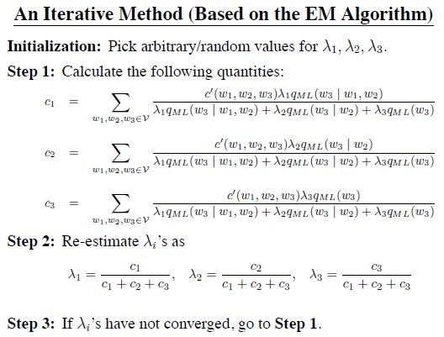
[slide from Michael Collins]

Slide 14
NLP

